Slide 1
CONTENTS OF A TEST POLICY DOCUMENT
A test policy is a high-level document that defines the overall vision, goals, and principles of testing in an organization.
It describes the roles and responsibilities of the test team, the test standards and processes, the test tools and techniques, and the quality criteria and metrics.

Slide 2
Contents of a Test Policy Document
DEFINITION OF TESTING
DESCRIPTION OF THE TEST PROCESS
TEST EVALUATION
QUALITY LEVEL TO BE ACHIEVED
APPROACH TO TEST PROCESS IMPROVEMENT

Slide 3
DEFINITION OF TESTING
ORGANIZATIONS NEED TO BE CLEAR WHY THEY ARE TESTING.
THIS WILL INFLUENCE THE REMAINDER OF THE POLICY DOCUMENT AND ALSO THE DETAILED TESTING TECHNIQUES THAT ARE SELECTED BY TEST MANAGERS AT THE PROGRAMME AND PROJECT LEVEL.

Slide 4
DESCRIPTION OF THE TEST PROCESS
IT IS VITAL TO ESTABLISH A SOLID VIEW TOWARDS THE TEST PROCESS.
SHOULD ADDRESS QUESTIONS LIKE, WHICH PHASES AND SUBTASKS WILL THE TEST PROCESS INCLUDE, WHICH ROLES WILL BE INVOLVED AND THE DOCUMENT STRUCTURE ASSOCIATED WITH EACH TASKS, AS WELL AS WHAT TEST LEVELS NEED TO BE CONSIDERED.
EXAMPLE:
“ALL TEST PLANS ARE WRITTEN IN ACCORDANCE WITH COMPANY POLICY”

Slide 5
TEST EVALUATION
HOW ARE WE GOING TO EVALUATE THE RESULTS OF TESTING.
WHAT MEASURES WILL WE USE TO ENSURE TEST EFFECTIVENESS IN THE PROJECT?
EXAMPLE:
“EFFECT ON BUSINESS OF FINDING A FAULT AFTER ITS RELEASE”

Slide 6
QUALITY LEVEL TO BE ACHIEVED
WHICH QUALITY CRITERIA ARE GOING TO BE TESTED AND WHICH QUALITY LEVEL IS THE SYSTEM REQUIRED TO ACHIEVE PRIOR TO ITS RELEASE WITH REGARDS TO THESE CRITERIA?
From a software product perspective, quality refers to characteristics like reliability, usability, performance, and security.
From a process perspective, it refers to using disciplined methods and best practices that are likely to result in a higher quality product.
EXAMPLE:
“NO OUTSTANDING HIGH SEVERITY FAULTS PRIOR TO PRODUCTS RELEASE”

Slide 7
APPROACH TO TEST PROCESS IMPROVEMENT
HOW OFTEN AND WHEN ARE WE GOING TO ASSESS THE USEFULNESS OF THE CURRENT PROCESSES IN PLACE
WHAT ELEMENTS NEED IMPROVING AND TECHNIQUES THAT SHALL BE USED TO IMPROVE THE PROCESSES.
Test process improvement is an important phase to create a direct impact on testing and development.
An improved process is not only more capable of finding better bugs but also testing the application in ways that uplift its quality and standards.
EXAMPLE:
“PROJECT REVIEW MEETINGS TO BE HELD AFTER PROJECT COMPLETION”

Slide 8
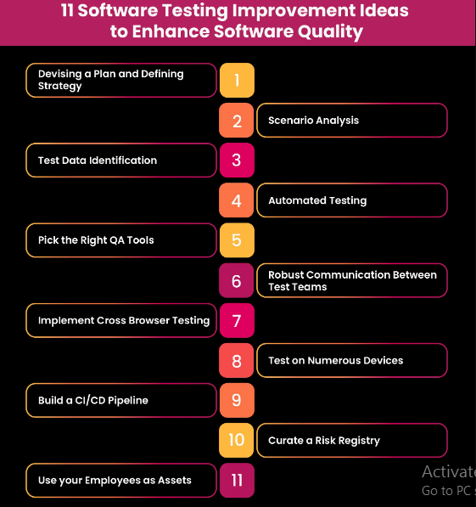

Slide 9
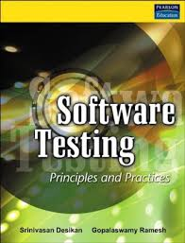



REFERENCES

